Slide 1

BUILDING THEME-BASED VULNERABLE MACHINES FOR CAPTURE THE FLAG (CTF) CHALLENGES

Slide 2
Contents
Introduction to Vulnerable Machines
Objectives
Understanding Vulnerable Machines
Motivation for Creating Vulnerable Machines
Converting Vulnerable Machines into Capture The Flag (CTF) Challenges
Lets design a CTF on our own

Slide 3
Introduction to Vulnerable Machines
What is a vulnerable machine?
Vulnerable machines are simulated environments intentionally designed with security vulnerabilities.
These vulnerabilities mimic real-world scenarios and provide hands-on learning opportunities for cybersecurity enthusiasts and professionals.

Slide 4
Objectives of the Seminar
Understanding Vulnerable Machines
Motivation for Creating Vulnerable Machines
Converting Vulnerable Machines into Capture The Flag (CTF) Challenges
How to build a vulnerable CTF machine
Understanding the machine from attackers perspective

Slide 5
Understanding Vulnerable Machines
Why intentionally build a vulnerable machine?
Vulnerable machines serve as invaluable tools in cybersecurity education by allowing learners to interact with and exploit security flaws in a controlled environment.
This practical approach enhances understanding, problem-solving skills, and readiness to address cybersecurity threats effectively.

Slide 6
Motivation for Creating Vulnerable Machines
Practical Learning: They offer hands-on experience, translating theoretical knowledge into real-world skills.
Real-World Relevance: Simulating cyber threats prepares learners for real-world cybersecurity challenges.
Skill Development: Interacting with vulnerable machines enhances essential cybersecurity skills.
Continuous Improvement: Vulnerable machines support ongoing learning and skill development in the ever-evolving field of cybersecurity.

Slide 7
Converting Vulnerable Machines into Capture The Flag (CTF) Challenges
Scenario Development: Craft engaging narratives and scenarios around vulnerabilities to create immersive CTF challenges with clear objectives.
Puzzle Design: Integrate vulnerabilities into puzzles and challenges that require participants to apply cybersecurity skills to progress and achieve goals.
Flag Placement: Strategically place "flags" or hidden tokens within the vulnerable machine, rewarding participants for successful exploitation and progression.
Scoring System: Implement a scoring system based on the difficulty of challenges, encouraging participants to tackle various levels of complexity.

Slide 8
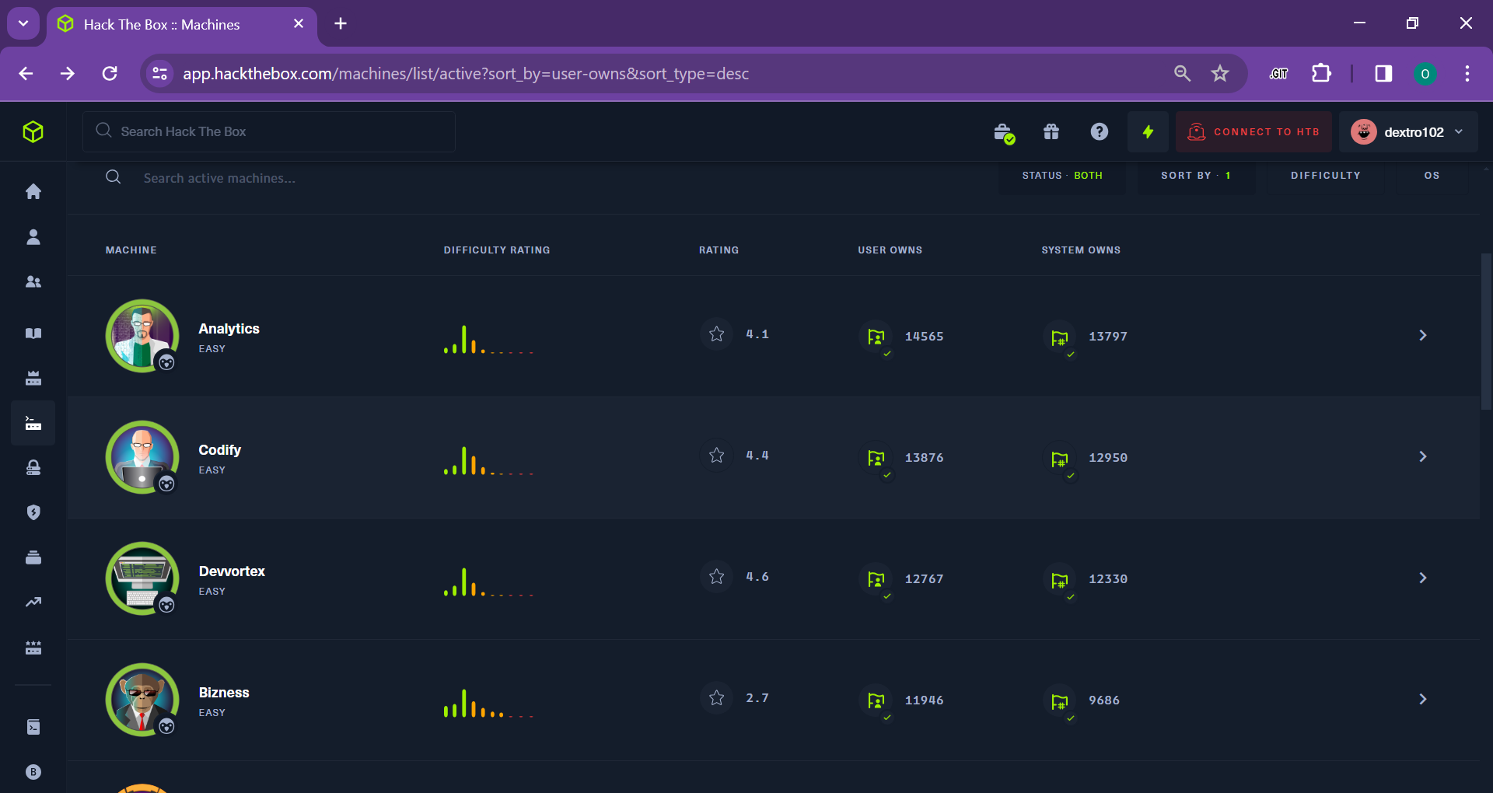
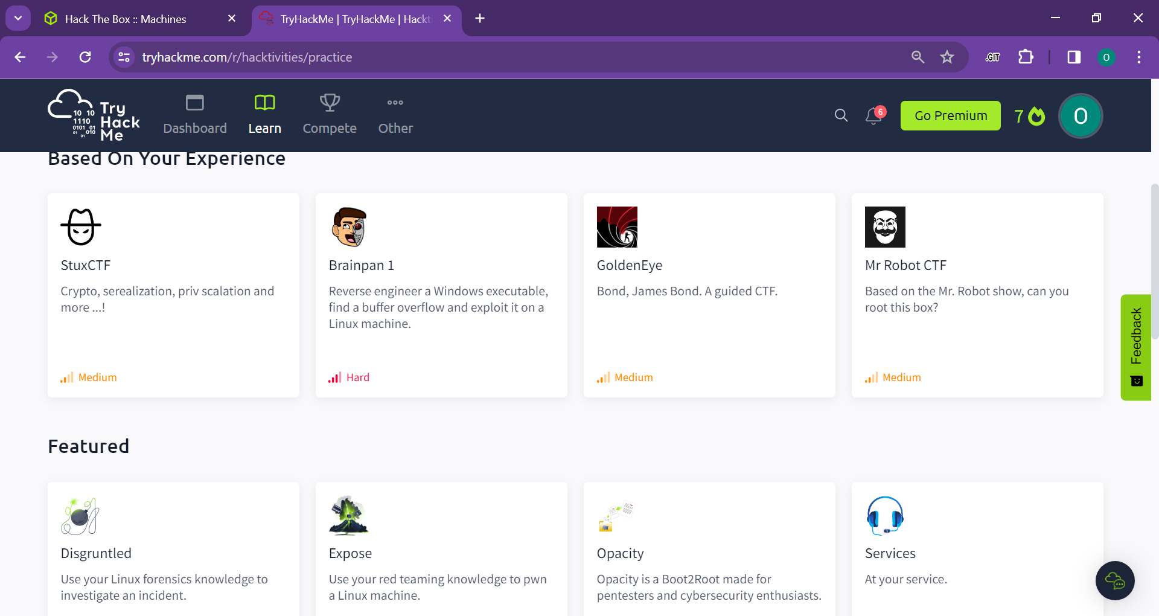
Just like Code Chief
HACK THE BOX(HTB) TRY HACK ME (THM)

Slide 9
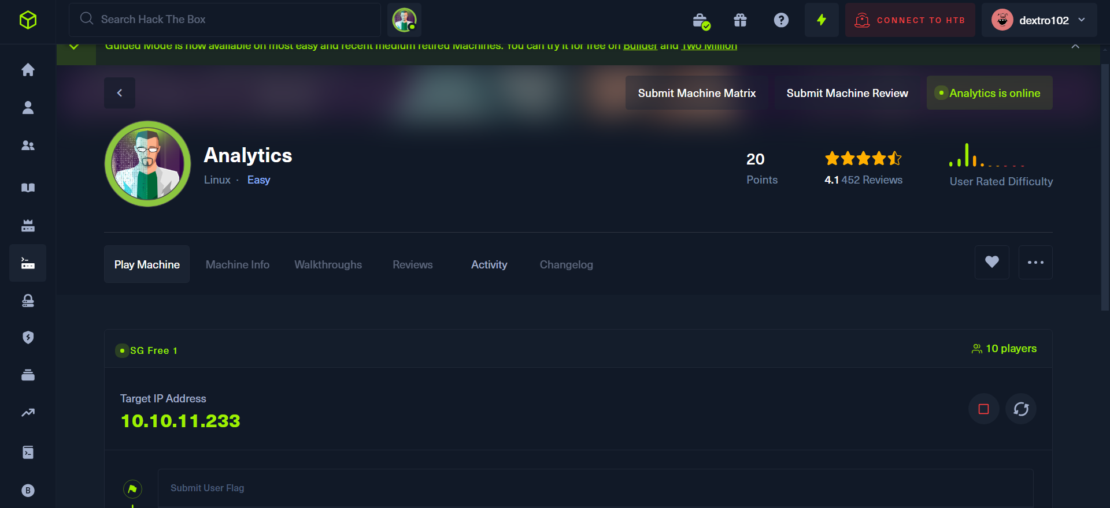
Hack Your Way In

Slide 10
Lets design a CTF on our own
Major steps:
PLAN
DESIGN
BUILD
TEST

Slide 11
PLAN
WHAT IS THE WAY IN?
INITIAL ACCESS
PRIVILEGE ESCALATION VECTOR
ROOT FLAG

Slide 12
PLAN
What is the way in ?
->though a misconfiguration in FTP that allows anonymous access
How will the attacker gain initial access
->Though leaked credentials
Root flag
->Inaccessible to normal user
Privilege escalation vector
->Exploiting a binary running with SUID permissions and environment path

Slide 13
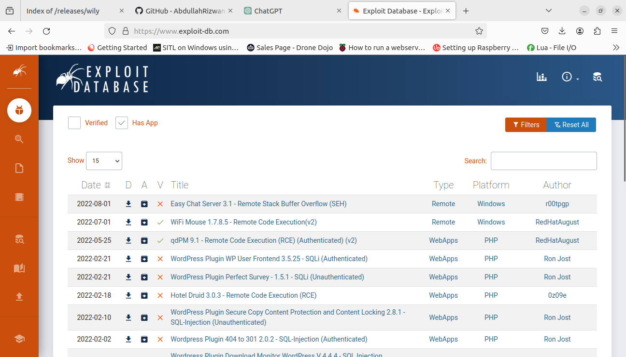
Ready made exploits and there environments

Slide 14
Lets start
Theme selection:
MESWCOE(college theme)
Requirements:
Virtual box
Vagrant
Code editor

Slide 15
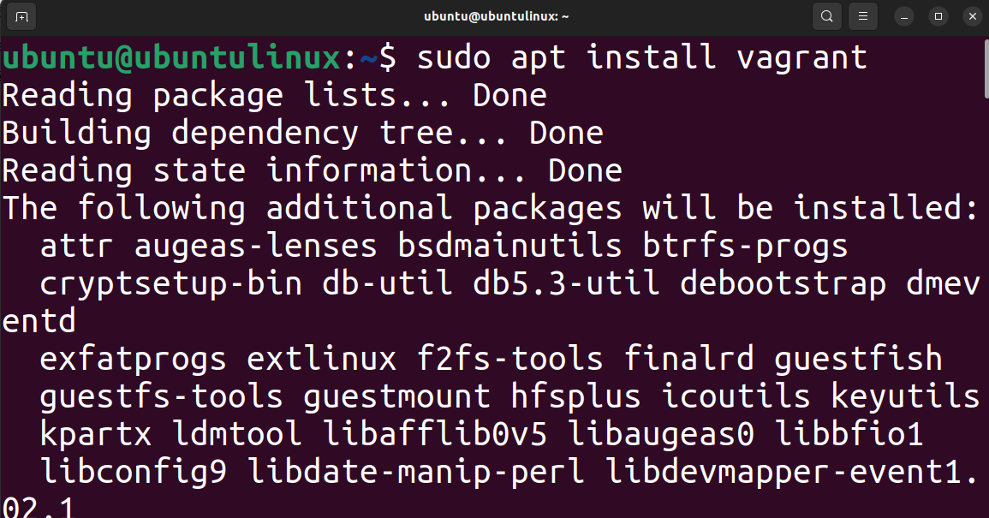
INSTALLING VAGRANT

Slide 16
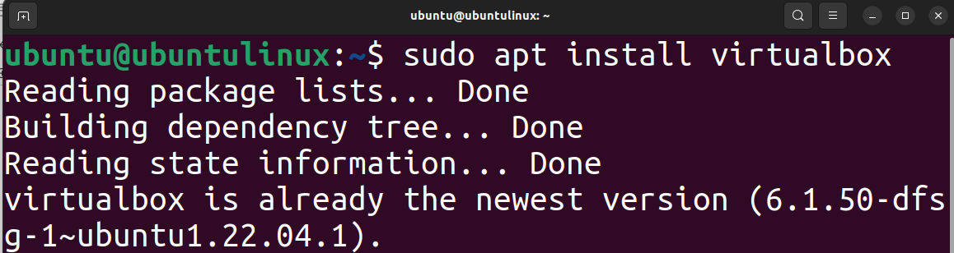
INSTALLING VIRTUAL BOX

Slide 17
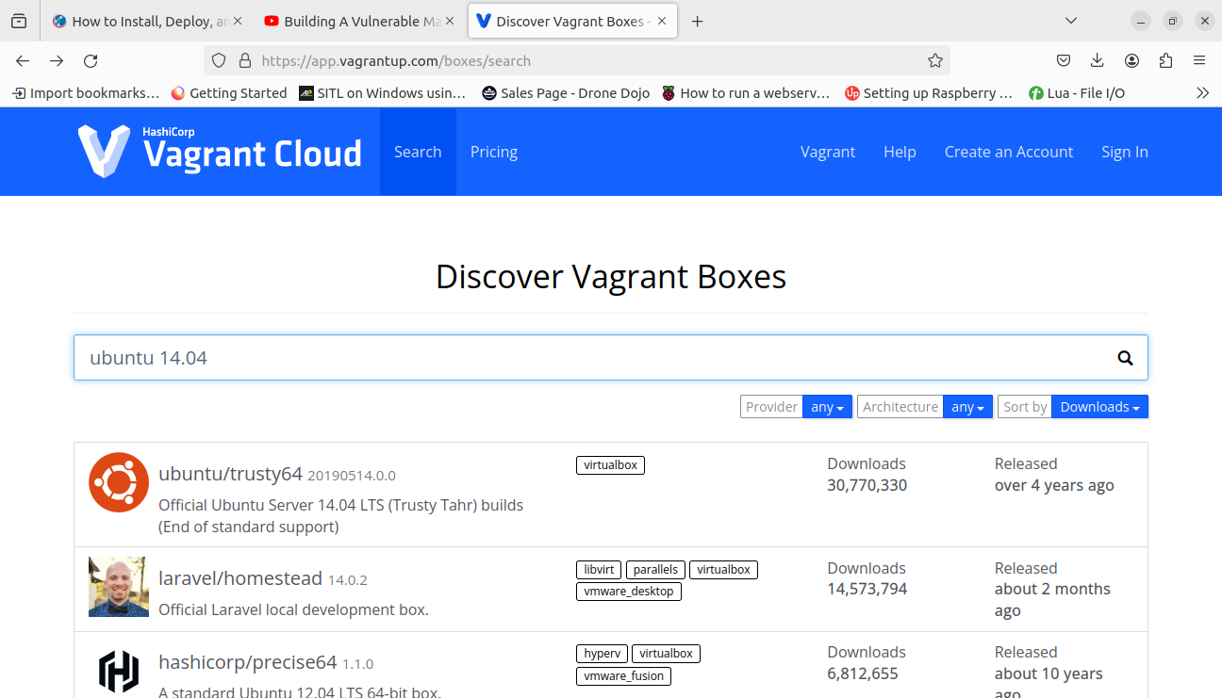
SELECTING BASE MACHINE

Slide 18
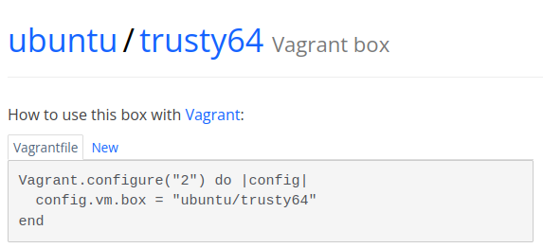
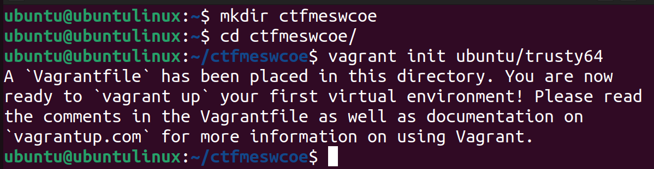

Slide 19
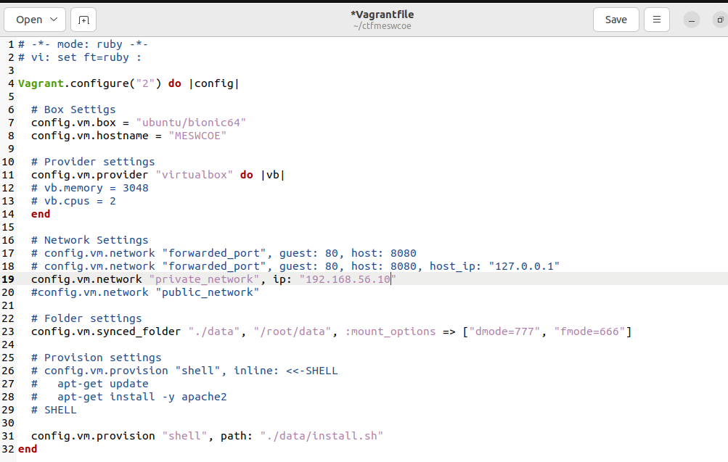
HOSTNAME
IP ADDRESS
SCRIPT INSTALLATION PATH

Slide 20
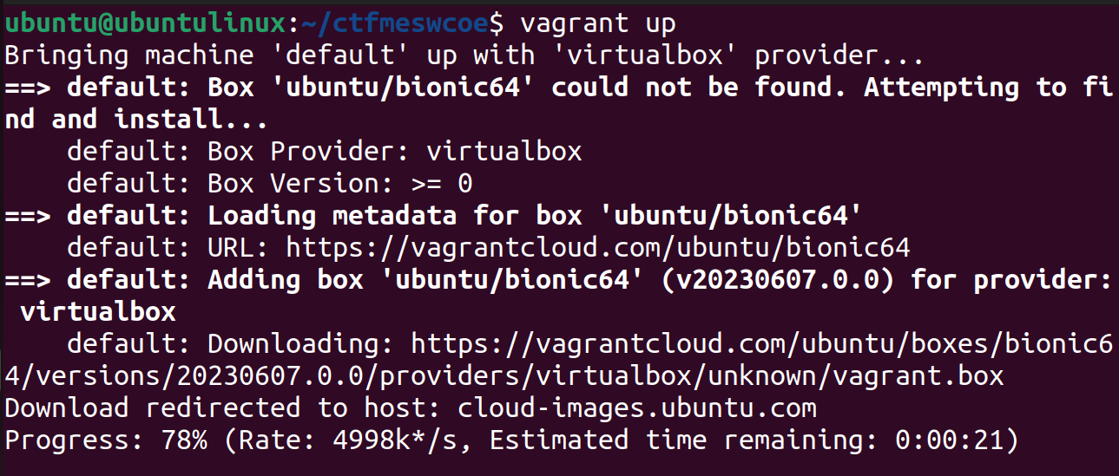
BOOTING UP THE MACHINE

Slide 21
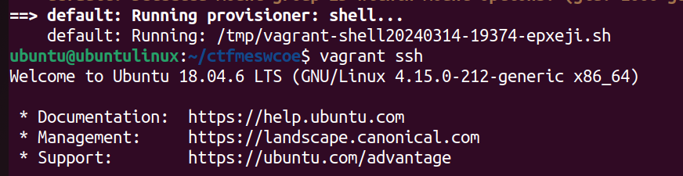
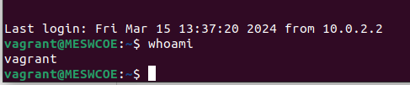
CONNECTING TO THE MACHINE

Slide 22
best way of crating a machine is Manual + Automatic
Manual Approach:
To check if all the commands are been executed properly
Error recognition and correction
Automatic Approach:
Fast build up
Creates environment instantaneously

Slide 23
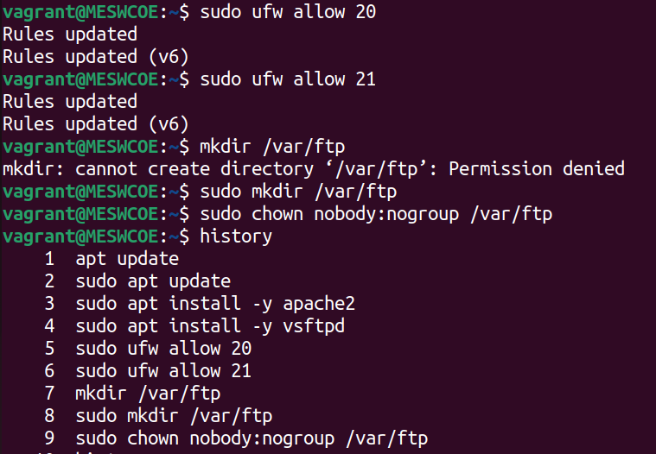
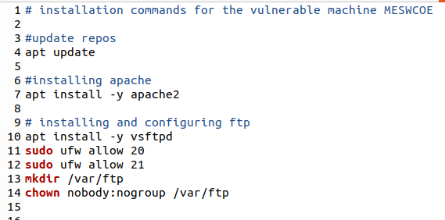
Manual Automatic

Slide 24
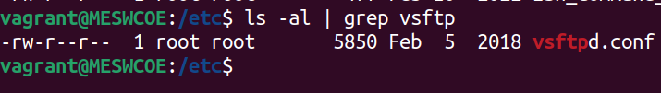
Inducing Misconfiguration

Slide 25
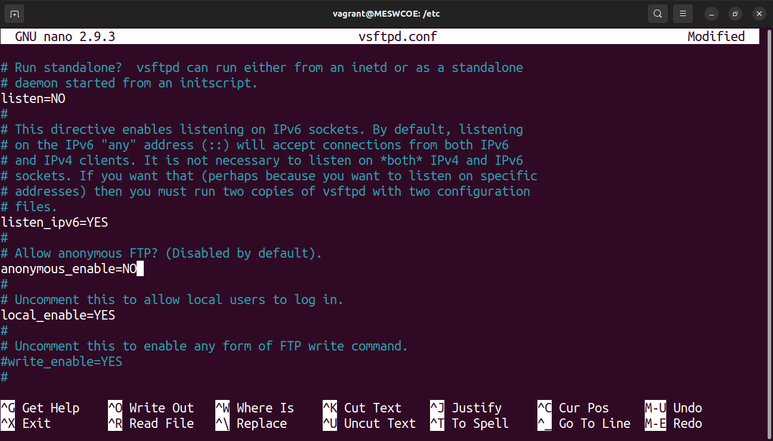
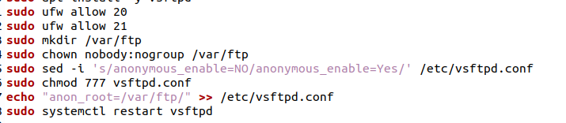
Enabling anonymous access
Misconfiguring to YES

Slide 26
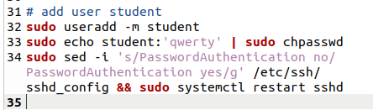
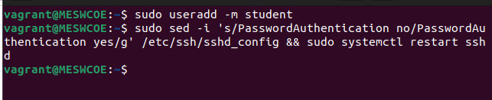
Adding low privilege user

Slide 27
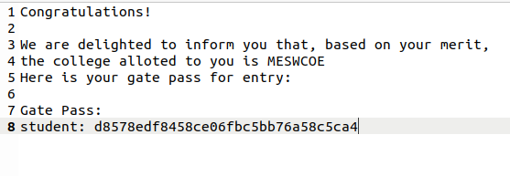
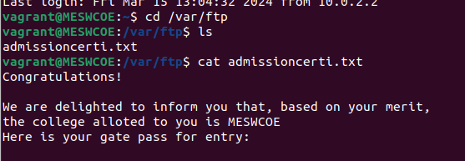
Password leak file (admissioncerti.txt)

Slide 28
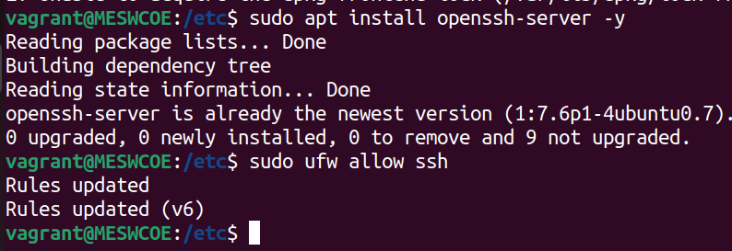
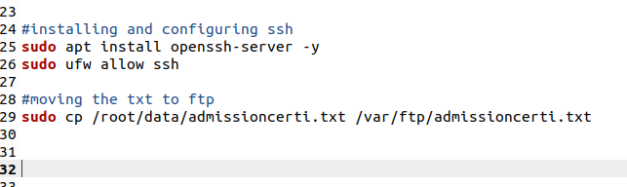
Initial Access

Slide 29
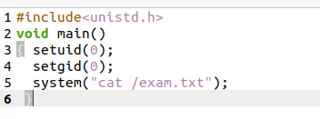
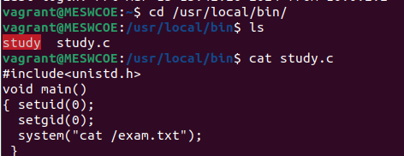
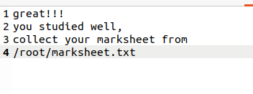
Privilege Escalation Vector (study)
vector
Only readable by root

Slide 30
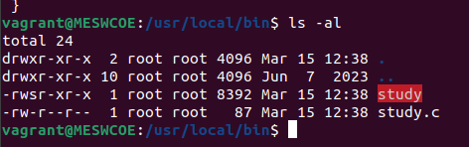
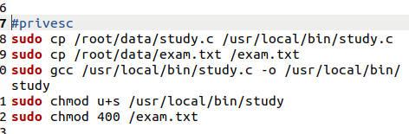
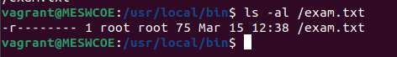
Setting up SUID Bit

Slide 31
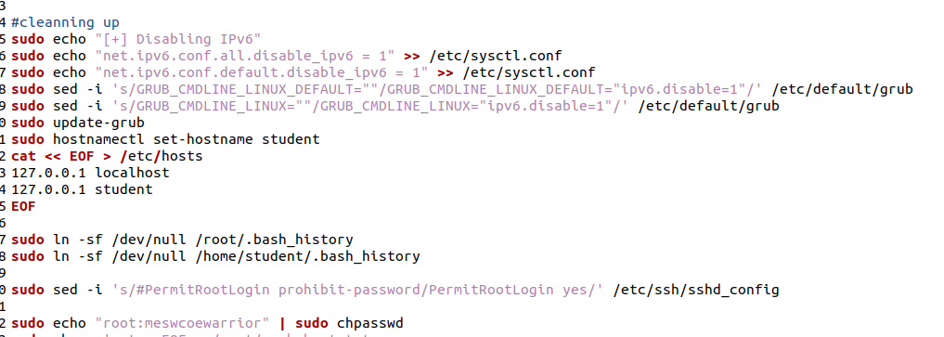
Cleaning history and setting Root password

Slide 32
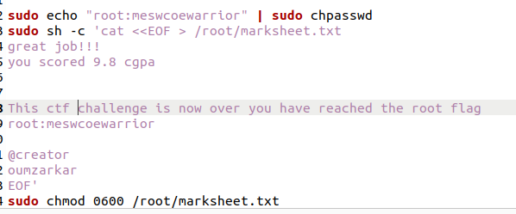
Setting Root Flag

Slide 33
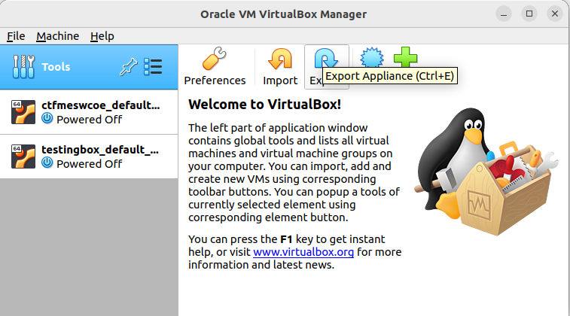
Exporting the Machine

Slide 34
Attacker’s perspective
Attacker’s description:
Smart and a quick thinker
Experienced CTF player

Slide 35
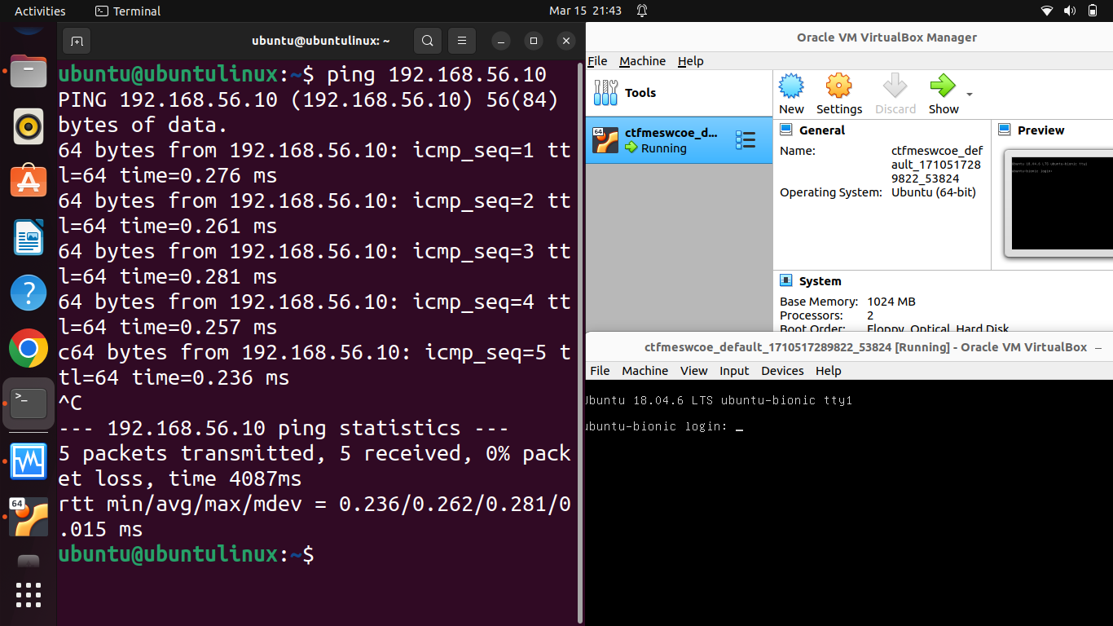
@attacker’s machine
@target machine(MESWCOE)

Slide 36
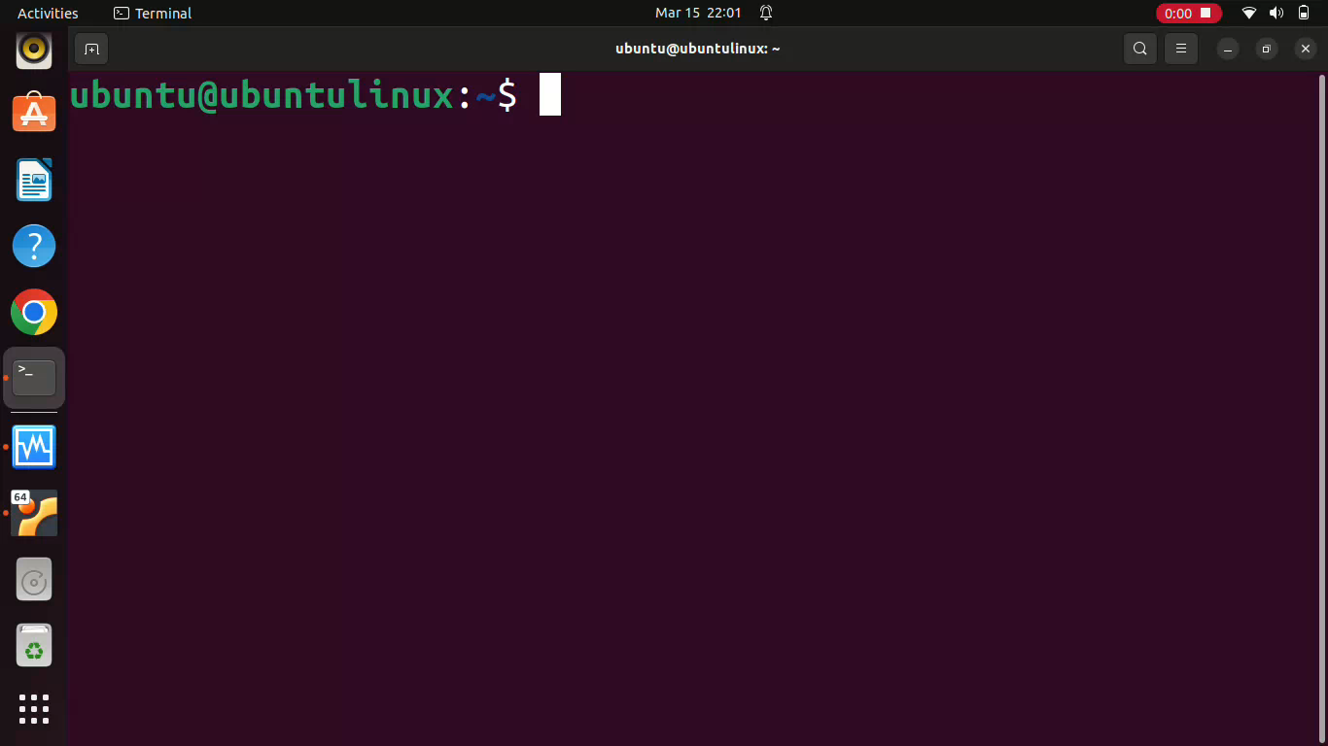

Slide 37
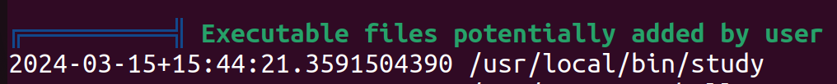
What is linpeas.sh
LINPEAS is a widely-used script for Linux privilege escalation. It automates the process of finding misconfigurations and vulnerabilities on Linux systems, aiding in escalating privileges during security assessments and penetration tests.

Slide 38
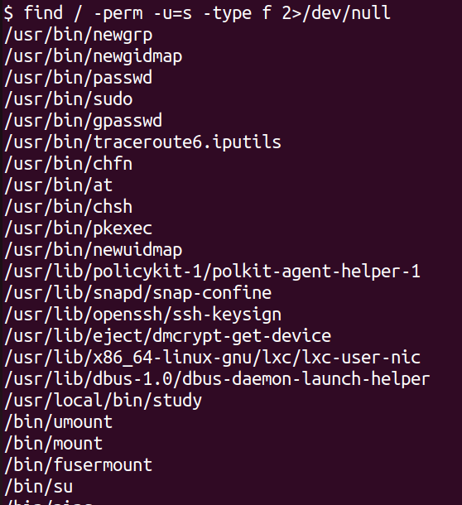
ALTERNATIVE METHOD

Slide 39
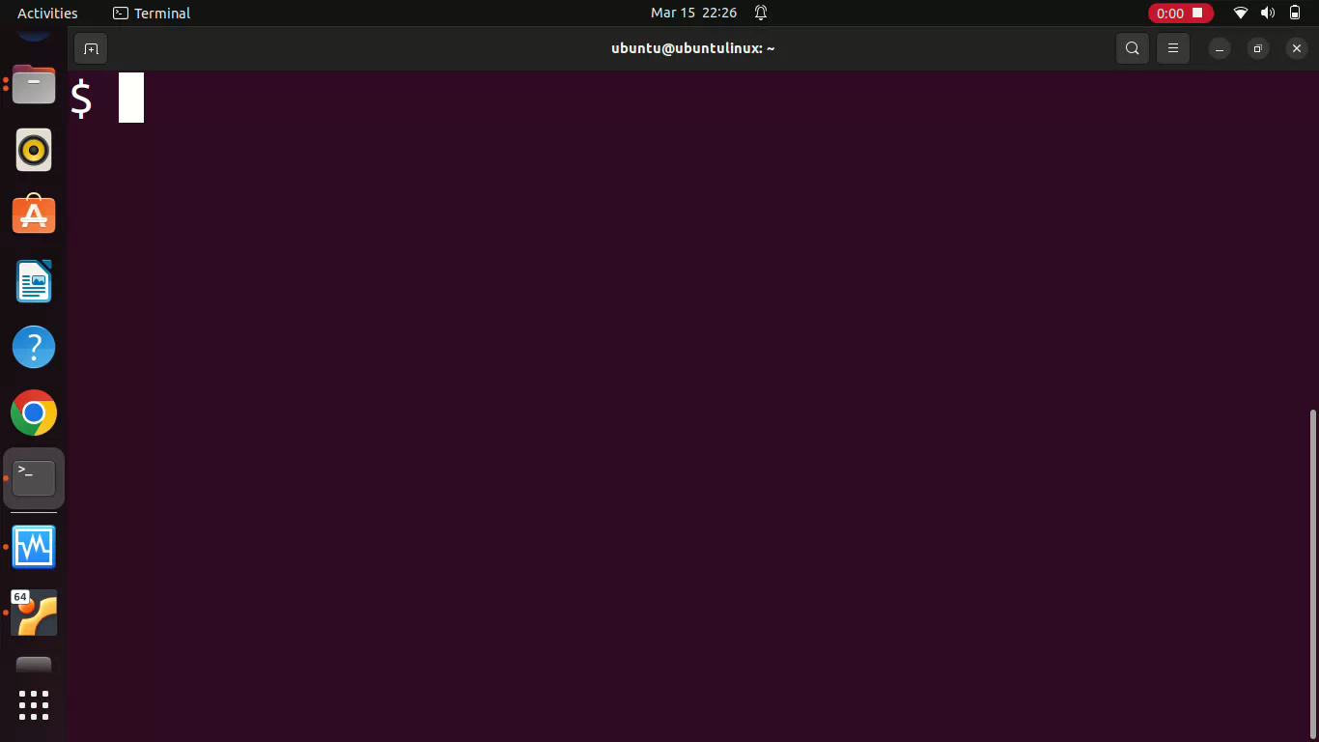

Slide 40
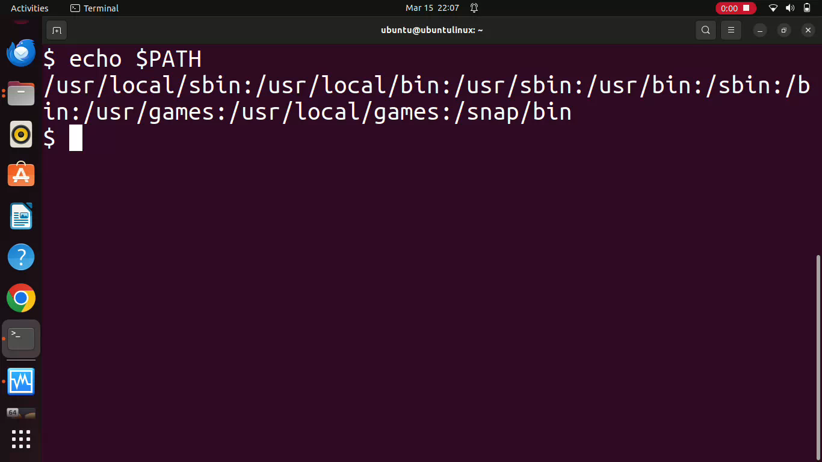

Slide 41
THANK YOU

